Slide 1
A. VSEPR Theory
1. Valence Shell Electron Pair Repulsion Theory = VSPER
2. Electron pairs orient themselves in order to minimize repulsive forces.

Slide 2
B. Types of e⁻ Pairs
1. Bonding pairs - form bonds
2. Lone pairs - nonbonding e⁻
Lone pairs repel more strongly than bonding pairs!!!

Slide 3
3. Lone pairs reduce the bond angle between atoms.
Lone pairs
Bond Angle

Slide 4
C. Determining Molecular Shape
1. Draw the Lewis Diagram.
2. Tally up e⁻ pairs on central atom
3. double/triple bonds = ONE pair
4. Shape is determined by the # of bonding pairs and lone pairs.
Know linear, trigonal planar, and tetrahedral shapes (all the tetrahedral options)

Slide 5
D. Common Molecular Shapes
1. Linear
2 total
2 bond
0 lone
LINEAR
180°
BeH₂

Slide 6
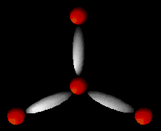
2. Trigonal Planar
3 total
3 bond
0 lone
BF₃
TRIGONAL PLANAR
120°

Slide 7
3. Bent <120º
3 total
2 bond
1 lone
SO₂
BENT
<120°

Slide 8
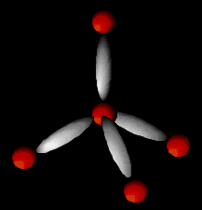
4. Tetrahedral
4 total
4 bond
0 lone
CH₄
TETRAHEDRAL
109.5°

Slide 9
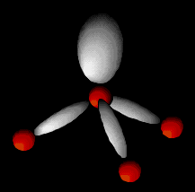
5. Trigonal Pyramidal
4 total
3 bond
1 lone
NH₃
TRIGONAL PYRAMIDAL
107°

Slide 10
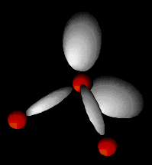
6. Bent 104.5º
4 total
2 bond
2 lone
H₂O
BENT
104.5°

Slide 11
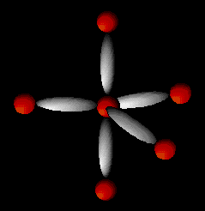
7. Trigonal Bipyramidal
5 total
5 bond
0 lone
PCl₅
TRIGONAL BIPYRAMIDAL
120°/90°

Slide 12
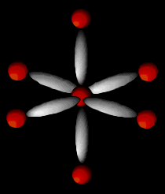
8. Octahedral
6 total
6 bond
0 lone
SF₆
OCTAHEDRAL
90°

Slide 13
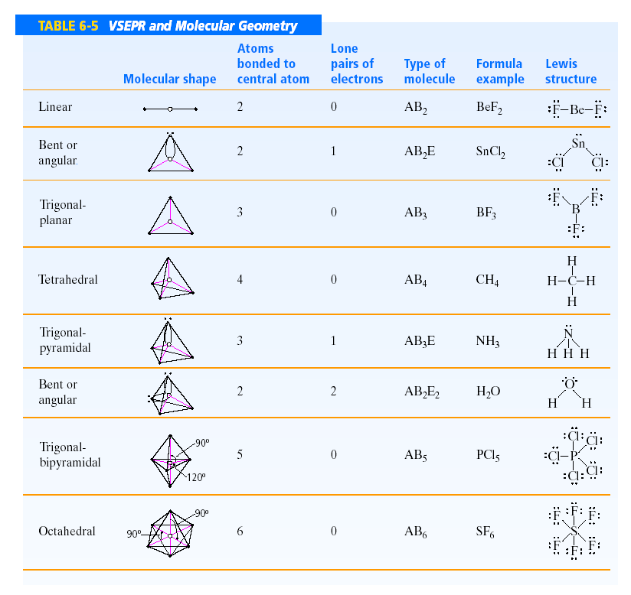

Slide 14
E. Examples
F P F
F
PF₃
4 total
3 bond
1 lone
TRIGONAL PYRAMIDAL
107°

Slide 15
O C O
CO₂
2 total
2 bond
0 lone
LINEAR
180°

