Slide 1
Chapter 6
Chemical Bonding

Slide 2
I. Intro
What is chemical bonding?
1. the combining of two or more atoms together
2. the creating of more stable arrangements of matter

Slide 3
B. What is a chemical bond?
1. an electrical attraction between the nuclei and valence e- of different atoms = bind together
2. valence e- in outmost energy level, all e- in that level (up to 8)
ex. Oxygen 1s²2s²2p⁴
so has 6 valence e-
ex. Ca 1s²2s²2p⁶3s²3p⁶4s² =?

Slide 4
1+
2+
3+
3-
2-
1-

Slide 5
C. Why chemical bonds occur
1. to decrease potential energy
this is the way nature likes matter – at minimized PE
2. also increases stability of matter
ALL matter wants a noble gas e- configuration = STABLE;
a total of 8 valence e-

Slide 6
II. Types of Bonding
A. 3 major types of bonding
1. Ionic bonding – bonds between cations and anions
a. metal and nonmetals
b. oppositely charged atoms
c. e- are transferred

Slide 8
2. Covalent bonding – sharing of electron pairs
a. nonmetals to nonmetals
b. e- are shared equally between 2 atoms

Slide 10
3. Metallic bonding –
a. metal and metal
b. sea of free-moving electrons

Slide 12
B. Which type of bonding?
1. Rarely is there a pure covalent or ionic bond
2. Usually a mixture of the two
3. Type is based on electronegativity or
the ability to attract electrons
4. Calculating the difference in the two element’s electronegativity determines if ionic or covalent

Slide 13
5. differences:
a. If difference is 1.7 or higher than it is ionic
b. 0.3 to 1.7 than polar covalent
c. 0 to 0.3 is nonpolar covalent

Slide 14
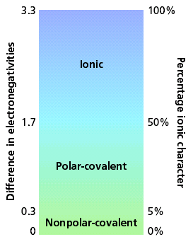

Slide 15
6. Ex.
a. calcium chlorine: 3.0 – 1.0 = 2.0
ionic
b. oxygen chlorine: 3.5 – 3.0 = 0.5
polar covalent
c. chlorine bromine: 3.0 – 2.8 = 0.2
nonpolar covalent

Slide 16
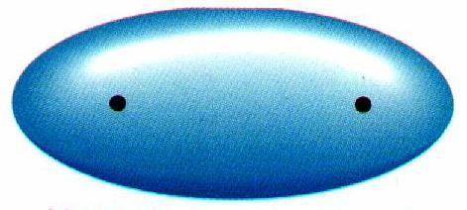
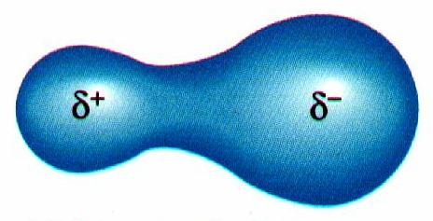
7. Nonpolar covalent is an even distribution of electrical charge
usually between same atoms Ex. O₂
8. Polar covalent is an uneven distribution of electrical charges
meaning one atom has a greater “pull” than the other

Slide 17
9. So
a. a large difference in electronegativity will result in an ionic bond
b. and a small difference will result in a covalent bond

Slide 18
III. Covalent bonds
A. Nonmetals hold on to their valence electrons.
1. They can’t give away e- to bond.
2. Still want noble gas configuration.
3. Get it by sharing valence electrons with each other.
4. By sharing, both atoms get to count the electrons toward a noble gas configuration.

Slide 19
B. Ex.
Fluorine has seven valence electrons
F

Slide 20
Fluorine has seven valence electrons
A second atom also has seven
F
F

Slide 21
Fluorine has seven valence electrons
A second atom also has seven
By sharing electrons…
F
F

Slide 22
Fluorine has seven valence electrons
A second atom also has seven
By sharing electrons…
F
F

Slide 23
Fluorine has seven valence electrons
A second atom also has seven
By sharing electrons…
F
F

Slide 24
Fluorine has seven valence electrons
A second atom also has seven
By sharing electrons…
F
F

Slide 25
Fluorine has seven valence electrons
A second atom also has seven
By sharing electrons…
F
F

Slide 26
Fluorine has seven valence electrons
A second atom also has seven
By sharing electrons…
…both end with full orbitals
F
F

Slide 27
Fluorine has seven valence electrons
A second atom also has seven
By sharing electrons…
…both end with full orbitals
F
F
8 Valence electrons

Slide 28
Fluorine has seven valence electrons
A second atom also has seven
By sharing electrons…
…both end with full orbitals
F
F
8 Valence electrons

Slide 29
C. A Single Covalent Bond is...
1. A sharing of two valence electrons.
2. Only nonmetals and Hydrogen.
3. Different from an ionic bond because they actually form molecules.
4. Two specific atoms are joined.
5. In an ionic solid, you can’t tell which atom the electrons moved from or to

Slide 30
6. Ex. Water
a. Each hydrogen has 1 valence electron
b. Each hydrogen wants 1 more
c. The oxygen has 6 valence electrons
d. The oxygen wants 2 more
e. They share to make each other happy
H
O

Slide 31
f. Put the pieces together
g. The first hydrogen is happy
h. The oxygen still wants one more
H
O

Slide 32
i. The second hydrogen attaches
j. Every atom has full energy levels
H
O
H

Slide 33
D. Multiple Covalent Bonds
1. Sometimes atoms share more than one pair of valence electrons.
2. A double bond is when atoms share two pairs (4 total) of e-
3. A triple bond is when atoms share three pairs (6 total) of electrons

Slide 34
4. Ex. Carbon dioxide
a. CO₂ - Carbon is central atom ( more metallic )
b. Carbon has 4 valence electrons
c. Wants 4 more
d. Oxygen has 6 valence electrons
e. Wants 2 more
C
O

Slide 35
f. Attaching 1 oxygen leaves the oxygen 1 short, and the carbon 3 short
C
O

Slide 36
g. Attaching the second oxygen leaves both oxygen 1 short and the carbon 2 short
O
C
O

Slide 37
h. The only solution is to share more
O
C
O

Slide 38
h. The only solution is to share more
O
C
O

Slide 39
h. The only solution is to share more
O
C
O

Slide 40
h. The only solution is to share more
O
C
O

Slide 41
h. The only solution is to share more
O
C
O

Slide 42
The only solution is to share more
O
C
O

Slide 43
h. The only solution is to share more
1) Requires two double bonds
2) Each atom can count all the electrons in the bond
O
C
O

Slide 44
h. The only solution is to share more
1) Requires two double bonds
2) Each atom can count all the electrons in the bond
8 valence electrons
O
C
O

Slide 45
h. The only solution is to share more
1) Requires two double bonds
2) Each atom can count all the electrons in the bond
8 valence electrons
O
C
O

Slide 46
h. The only solution is to share more
1) Requires two double bonds
2) Each atom can count all the electrons in the bond
8 valence electrons
O
C
O

Slide 47
IV. Ionic Bonding
A. Ionic = anion and cation
1. anions and cations are held together by opposite charges
2. Ionic compounds are called salts
3. The bond is formed through transferring of e-
4. e- are transferred to achieve noble gas configuration

Slide 48
5. Most ionic compounds exist as crystalline solids
Ex. Rocks and minerals
6. ionic compounds form large three dimensional networks
this allows for an equal attraction throughout the compound

Slide 49
B. Properties of a crystalline structure
1. A repeating arrangement of solids
whereas covalent is not repeating
2. Makes ionic bonds very strong
3. Makes for very high melting points
whereas covalent is lower melting points
4. A rigid structure

Slide 50
Crystalline structure

Slide 51
C. How Ionic bonding occurs
Na
Cl

Slide 52
1. Notice the Na has a + charge and chloride has a negative charge
Na⁺
Cl⁻

Slide 53
2. Another example
a) All the electrons must be accounted for!
Ca
P
b) P only has 5 valence e- wants to get to 8 so must add 3 more e-

Slide 54
Ca
P

Slide 55
c) now P has only 7 e- needs 1 more
Ca²⁺
P

Slide 56
d) must add another Ca atom
Ca²⁺
P
Ca

Slide 57
e) Now P has total of 8 e-
BUT the 2nd Ca has 1e- left
Ca²⁺
P ³⁻
Ca

Slide 58
so, must add another P atom
Ca²⁺
P ³⁻
Ca
P

Slide 59
f) Now the 2nd Ca is correct
BUT now the P needs two more e-
Ca²⁺
P ³⁻
Ca²⁺
P

Slide 60
g) add another Ca atom
Ca
Ca²⁺
P ³⁻
Ca²⁺
P

Slide 61
Ca
Ca²⁺
P ³⁻
Ca²⁺
P

Slide 62
h. FINALLY!!!!! All atoms are happy and all atoms have 8 valence e-
Ca²⁺
Ca²⁺
P ³⁻
Ca²⁺
P ³⁻

Slide 63
i) the final writing for the ionic bond is
= Ca₃P₂
Formula Unit
j) this is called a formula unit
a formula unit is the simplest collection of atoms from which an ionic compound’s formula can be written

